Slide 1
Understanding class definitions
Exploring source code
7.0

Slide 2
Main concepts to be covered
fields
constructors
methods
parameters
assignment statements

Slide 3
Ticket machines – an external view
Exploring the behavior of a typical ticket machine.
Use the naive-ticket-machine project.
Machines supply tickets of a fixed price.
How is that price determined?
How is ‘money’ entered into a machine?
How does a machine keep track of the money that is entered?

Slide 4
Ticket machines
Demo of naïve-ticket-machine

Slide 5
Ticket machines – an internal view
Interacting with an object gives us clues about its behavior.
Looking inside allows us to determine how that behavior is provided or implemented.
All Java classes have a similar-looking internal view.

Slide 6
Basic class structure
The outer wrapper of TicketMachine
public class TicketMachine
{
Inner part omitted.
}
public class ClassName
{
Fields
Constructors
Methods
}
The inner contents of a class

Slide 7
Keywords
Words with a special meaning in the language:
public
class
private
int
Also known as reserved words.
Always entirely lower-case.

Slide 8
Fields
Fields store values for an object.
They are also known as instance variables.
Fields define the state of an object.
Use Inspect to view the state.
Some values change often.
Some change rarely (or not at all).
public class TicketMachine
{
private int price;
private int balance;
private int total;
Further details omitted.
}
type
visibility modifier
variable name
private int price;

Slide 9
Constructors
Initialize an object.
Have the same name as their class.
Close association with the fields:
Initial values stored into the fields.
Parameter values often used for these.
public TicketMachine(int cost)
{
price = cost;
balance = 0;
total = 0;
}

Slide 10
Passing data via parameters
Parameters are another sort of variable.

Slide 11
Assignment
Values are stored into fields (and other variables) via assignment statements:
variable = expression;
balance = balance + amount;
A variable can store just one value, so any previous value is lost.
pattern
example

Slide 12
Choosing variable names
There is a lot of freedom over choice of names. Use it wisely!
Choose expressive names to make code easier to understand:
price, amount, name, age, etc.
Avoid single-letter or cryptic names:
w, t5, xyz123

Slide 13
Next concepts to be covered
Methods, including:
accessor (getter) methods
mutator (setter) methods;
String formatting;
Conditional statements;
Local variables.

Slide 14
Methods
Methods implement the behavior of objects.
Methods have a consistent structure comprised of a header and a body.
Accessor methods provide information about an object.
Mutator methods change the state of an object.
Other sorts of methods accomplish a variety of tasks.

Slide 15
Method structure
Accessor methods often occur in the form of getter methods.
The header:
public int getPrice()
The header tells us:
the visibility to objects of other classes (public);
whether the method returns a result (an integer);
the name of the method (getPrice);
whether the method takes parameters (none, in this case).
The body encloses the method's statements.

Slide 16
Getter methods
return type
visibility modifier
method name ('get' something)
parameter list (empty)
public int getPrice()
{
return price;
}
return statement
start and end of method body (block)

Slide 17
Accessor methods
An accessor method always has a return type that is not void.
An accessor method returns a value (result) of the type given in the header.
The method will contain a return statement to return the value.
NB: Returning is not printing!

Slide 18
Test
public class CokeMachine
{
private price;
public CokeMachine()
{
price = 300
}
public int getPrice
{
return Price;
}
What is wrong here? There are five errors.

Slide 19
Test
public class CokeMachine
{
private price;
public CokeMachine()
{
price = 300
}
public int getPrice
{
return Price;
}
What is wrong here? There are five errors.
int
;
()
-
}

Slide 20
Mutator methods
Have a similar method structure: header and body.
Used to mutate (i.e., change) an object’s state.
Achieved through changing the value of one or more fields.
They typically contain one or more assignment statements.
Often receive parameters.
The most basic mutator methods are 'setter' methods.

Slide 21
setter methods
Fields often have dedicated set mutator methods.
These have a simple, distinctive form:
void return type
method name related to the field name
single formal parameter, with the same type as the type of the field
a single assignment statement

Slide 22
A typical set method
public void setDiscount(int amount)
{
discount = amount;
}
We can easily infer that discount is a field of type int, i.e:
private int discount;

Slide 23
Protective mutators
A set method does not have to always assign unconditionally to the field.
The parameter may be checked for validity and rejected if inappropriate.
Mutators thereby protect fields.
Mutators support encapsulation.

Slide 24
Another mutator method
visibility modifier
return type
method name
formal parameter
public void insertMoney(int amount)
{
balance = balance + amount;
}
field being mutated
assignment statement
This method changes the value of balance; hence the object's state is mutated.

Slide 25
The this keyword
Used to distinguish parameters and fields of the same name. E.g.: public TicketMachine(int price) { this.price = price; balance = 0; total = 0; }

Slide 26
Printing from methods
public void printTicket()
{
// Simulate the printing of a ticket.
System.out.println("##################");
System.out.println("# The BlueJ Line");
System.out.println("# Ticket");
System.out.println("# " + price + " cents.");
System.out.println("##################");
System.out.println();
// Update the total collected with the balance.
total = total + balance;
// Clear the balance.
balance = 0;
}

Slide 27

String concatenation
4 + 5
9
"wind" + "ow"
"window"
"Result: " + 6
"Result: 6"
"# " + price + " cents"
"# 500 cents"
overloading
Notes:
try out in codepad

Slide 28
Quiz
System.out.println(5 + 6 + "hello");
System.out.println("hello" + 5 + 6);
11hello
hello56

Slide 29
Formatted printing
Concatenation can be used to create output in a desired format.
An alternative is to use printf.
The first argument gives the overall structure.
Format specifiers represent 'holes' to be filled in by the other arguments.

Slide 30
Formatted printing
Concatenation: System.out.println("# " + price + " cents.");
Using printf: System.out.printf("# %d cents.%n", price);
%d means insert the next argument as an integer value at this point.
%n means 'end the line' (i.e., 'insert' a newline) at this point.

Slide 31
Method summary
Methods implement all object behavior.
A method has a name and a return type.
The return-type may be void.
A non-void return type means the method will return a value to its caller.
A method might take parameters.
Parameters bring values in from outside for the method to use.

Slide 32
Reflecting on the ticket machines
Their behavior is inadequate in several ways:
No checks on the amounts entered.
No refunds.
No checks for a sensible initialization.
How can we do better?
We need the ability to choose between different courses of action.

Slide 33
Making choices in everyday life
If I have an assignment to complete, then I shall work on my assignment
Otherwise I shall visit a friend.

Slide 34
Making a choice in everyday life
if(I have an assignment to complete) {
I shall work on my assignment;
} else {
I shall visit a friend;
}

Slide 35
Making choices in Java
‘if’ keyword
boolean condition to be tested
actions if condition is true
if(perform some test) {
Do these statements if the test gave a true result
}
else {
Do these statements if the test gave a false result
}
actions if condition is false
‘else’ keyword

Slide 36
Making a choice in the ticket machine
public void insertMoney(int amount)
{
if(amount > 0) {
balance = balance + amount;
}
else {
System.out.printf( "Use a positive amount: %d%n", amount);
}
}
the conditional statement avoids an inappropriate action

Slide 37
Variables – a recap
Fields are one sort of variable.
They store values through the life of an object.
They are accessible throughout the class.
Parameters are another sort of variable:
They receive values from outside the method.
They help a method complete its task.
Each call to the method receives a fresh set of values.
Parameter values are short lived.

Slide 38
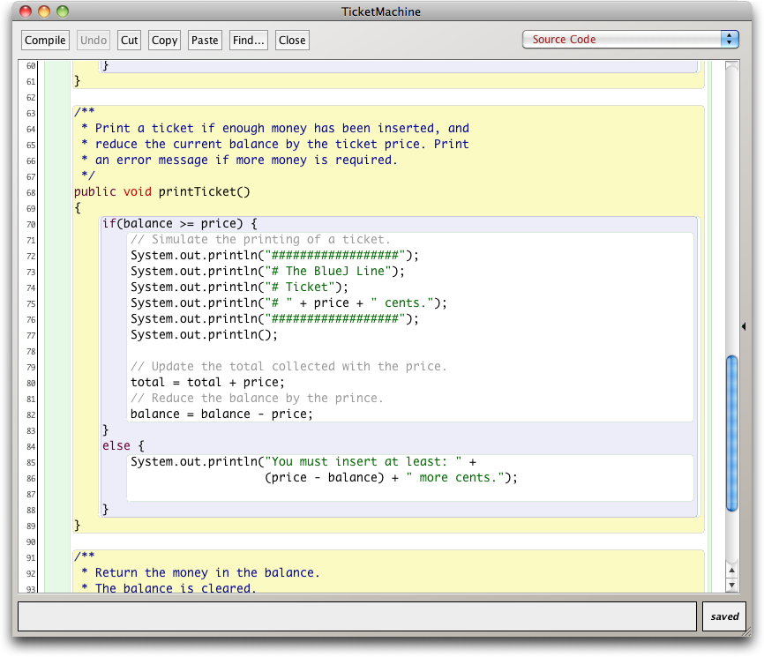
Scope highlighting

Slide 39
Scope and lifetime
Each block defines a new scope.
Class, method and statement.
Scopes may be nested:
statement block inside another block inside a method body inside a class body.
Scope is static (textual).
Lifetime is dynamic (runtime).

Slide 40
To think about
How could we write a method to ‘refund’ an excess balance?
We need to return the value in balance.
We need to set the balance to zero.
How can we do the first without losing the value in balance?
Notes:
write method in BlueJ;
first: do it wrong

Slide 41
Unsuccessful attempt
public int refundBalance()
{
// Return the amount left.
return balance;
// Clear the balance.
balance = 0;
}
It looks logical, but the language does not allow it.

Slide 42
Local variables
Methods can define their own, local variables:
Short lived, like parameters.
The method sets their values – unlike parameters, they do not receive external values.
Used for ‘temporary’ calculation and storage.
They exist only as long as the method is being executed.
They are only accessible from within the method.
They are defined within a particular scope.

Slide 43
Local variables
public int refundBalance()
{
int amountToRefund;
amountToRefund = balance;
balance = 0;
return amountToRefund;
}
A local variable
No visibility
modifier

Slide 44
Scope and lifetime
The scope of a field is its whole class.
The lifetime of a field is the lifetime of its containing object.
The scope of a local variable is the block in which it is declared.
The lifetime of a local variable is the time of execution of the block in which it is declared.

Slide 45
Review (1)
Class bodies contain fields, constructors and methods.
Fields store values that determine an object’s state.
Constructors initialize objects – particularly their fields.
Methods implement the behavior of objects.

Slide 46
Review (2)
Fields, parameters and local variables are all variables.
Fields persist for the lifetime of an object.
Local variables are used for short-lived temporary storage.
Parameters are used to receive values into a constructor or method.

Slide 47
Review (3)
Methods have a return type.
void methods do not return anything.
non-void methods always return a value.
non-void methods must have a return statement.

Slide 48
Review (4)
‘Correct’ behavior often requires objects to make decisions.
Objects can make decisions via conditional (if) statements.
A true-or-false test allows one of two alternative courses of actions to be taken.

